Slide 1

SQL Subqueries and Variables or, how to reuse results and query the results of other queries
Notes:
...
Hello everyone and welcome to our session!
In this session, we will dive deeper into one of the more advanced concepts of S-Q-L.
In particular, we will focus on subqueries and variables, which can enable very advanced data analysis to be performed on our data. Subqueries and variables allow us to reuse the results from one query and use them as part of another.
Subqueries are a powerful tool that can help us extract meaningful insights and make more informed decisions based on our data.
So, get ready to expand your SQL knowledge and learn how to use subqueries effectively in your data analysis.
Let's get started!

Slide 2
Subqueries for single-value calculation
and intro to variables

Slide 3
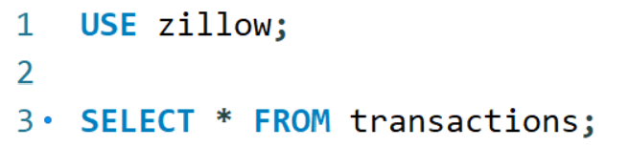
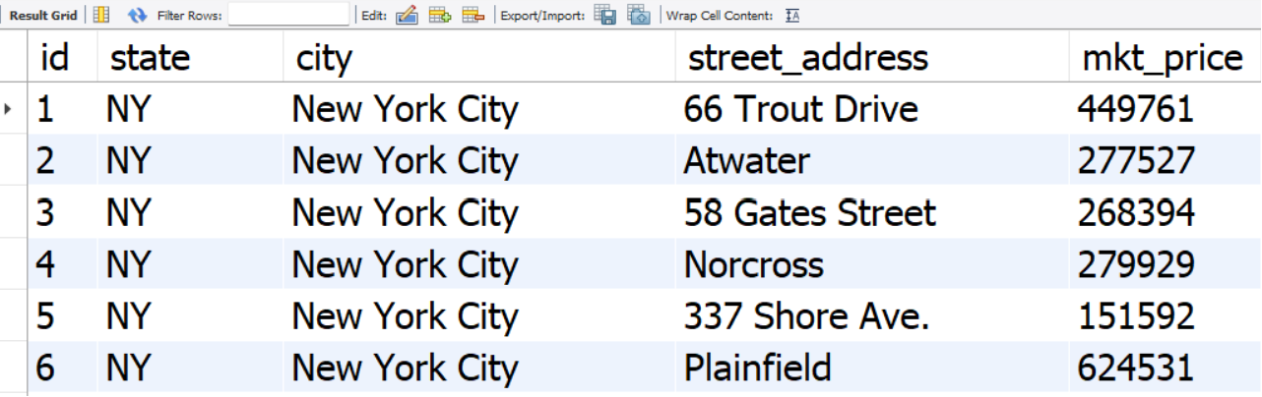
Motivating Example
Go to the Zillow database:
Singe table called “transactions,”
Five attributes: id, state, city, street address, and market price.
Tasks:
Compute the national average sale price across all houses in the database
List all cities and the average price of the houses in each city
List all cities and the average price of the houses for all cities where the average home price is above $550,122.52
List all cities and the average price of the houses for all cities where the average home price is above the national average
Notes:
Let's start with a motivating example. (Incidentally, this was an interview question at Zillow.)
For this example, we'll use a toy database called Zillow, which contains information on 100 house transactions in different cities.
It contains only one table called “transactions,” with five columns: id, state, city, street_address, and market price.
First, we want to calculate the national average price across all houses in the database.
Then, we want to calculate the average price for each city, and limit the results to cities with an average price that exceeds a threshold.
Finally, we want to identify which cities have an average price higher than the national average.

Slide 4
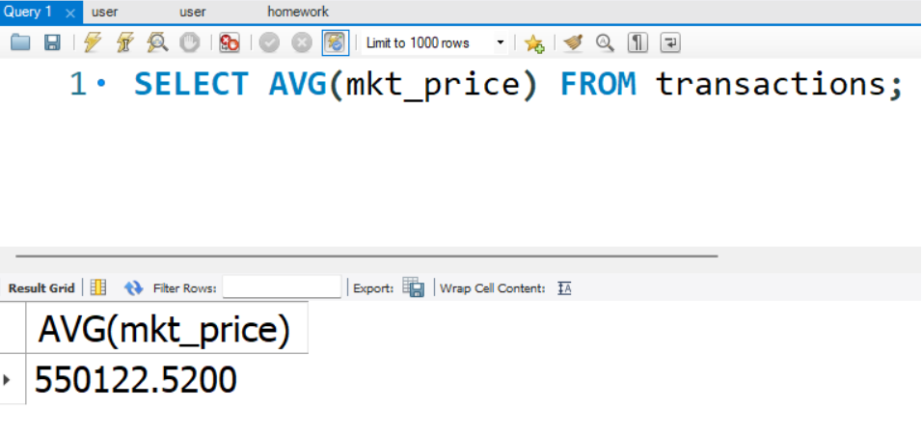
Need for Subqueries
Compute the national average sale price across all houses in the database
SELECT AVG(mkt_price) FROM transactions
Notes:
Let's write some SQL to get started.
Remember our end-goal: Identify which cities have an average price higher than the national average price.
We'll use a simple aggregation query to calculate the national average market price first:
SELECT
<break time="0.5s" />
average (market_price)
<break time="0.5s" />
FROM transactions;
The result is 550 thousand 122 dollars and 52 cents.

Slide 5
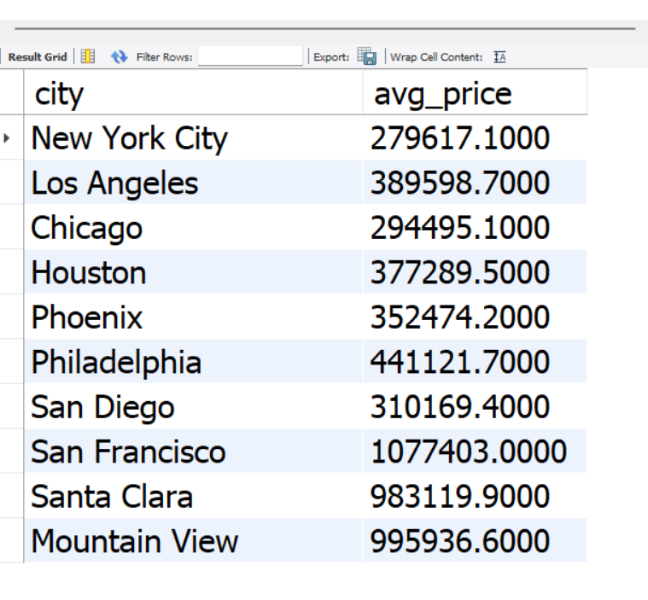
Need for Subqueries
Compute the national average sale price across all houses in the database
SELECT AVG(mkt_price) FROM transactions
List all cities and the average price of the houses in each city
SELECT city, AVG(mkt_price) AS avg_price
FROM transactions
GROUP BY city
Notes:
Next! <break time="0.25s" />
We want to calculate the average market price for each city.
We'll use a simple aggregation "GROUP BY" query to break down the results by city.
So, we take the existing query:
SELECT
average (market_price)
FROM transactions;
Then, we add a GROUP BY clause, to break down the calculation of the averages.
SELECT
<break time="0.5s" /> city,
Average (market_price) AS Average_price
FROM transactions
<break time="0.5s" />
GROUP BY city;
The result shows us the average price for each of the ten cities in the database.

Slide 6
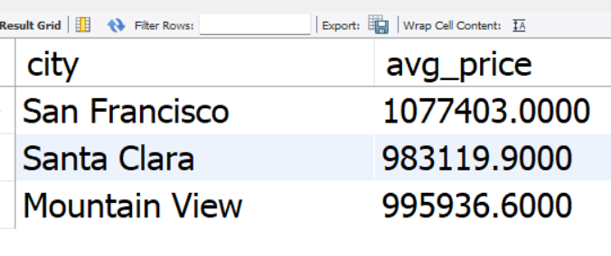
Need for Subqueries
Compute the national average sale price across all houses in the database
SELECT AVG(mkt_price) FROM transactions
List all cities and the average price of the houses in each city
SELECT city, AVG(mkt_price) AS avg_price
FROM transactions
GROUP BY city
List all cities and the average price of the houses for all cities where the average home price is above $550,122.52
SELECT city, AVG(mkt_price) AS avg_price
FROM transactions
GROUP BY city HAVING avg_price > 550,122.52
Notes:
Now that we have the average price for each city, we want to identify which cities have an average price higher than the national average.
Remember, from our first query, we know that the national average price is $550,122.52
So, we'll use a "HAVING" clause to filter the results and identify the three cities that meet this criterion:
SELECT
City, Average (market_price) AS Average_price
FROM transactions
GROUP BY city;
And we add the HAVING clause:
HAVING Average_price greater than 550 thousand 122 dollars and 52 cents.
So, the three cities that have a city-wide average price higher than the national average price are:
San Francisco,
Santa Clara, and
Mountain View.

Slide 7
Need for Subqueries
Compute the national average sale price across all houses in the database
SELECT AVG(mkt_price) FROM transactions
List all cities and the average price of the houses for all cities where the average home price is above $550,122.52
SELECT city, AVG(mkt_price) AS avg_price
FROM transactions
GROUP BY city HAVING AVG(mkt_price) > 550122.52
List all cities and the average price of the houses for all cities where the average home price is above the national average
SELECT city, AVG(mkt_price) AS avg_price
FROM transactions
GROUP BY city HAVING AVG(mkt_price) > (SELECT AVG(mkt_price) FROM transactions)
Notes:
So, the approach of computing first the national average price and then pasting the value in the query that calculates city averages works.
However, it requires copying and pasting the national average price from one query to another, which is not only error-prone but also makes our queries static: We need to update the average national price every time it changes.
To avoid this issue, we can directly use the first query, which calculates the national average, as part of a larger query.
<break time="0.5s" />
How to achieve that?
We take the query that calculates the national average, put it in parentheses, and then we can reuse the outcome as part of a larger query.
So we get:
SELECT
City, Average (market_price) AS Average_price
FROM transactions
GROUP BY city
HAVING Average_price greater than
And now, instead of having the numeric value, we write instead
Parenthesis
SELECT AVG(market_price) FROM transactions
Close parenthesis
<break time="0.5s" />
That's it!
Now, the new query works without copy-pasting and will always be up to date.
And that's the main advantage of subqueries in SQL.
We can compose complex queries by building on the results of previous queries.
Building step-by-step, you easily write queries that would have been hard or impossible without subqueries.
Next, let’s examine one small trick to make our query even more readable.

Slide 8
Alternative with Variables
Query starts becoming harder to read
SELECT city, AVG(mkt_price) AS avg_price
FROM transactions
GROUP BY city HAVING AVG(mkt_price) > (SELECT AVG(mkt_price) FROM transactions)
Compute the national average sale price across all houses in the database
SET @national_average = (SELECT AVG(mkt_price) FROM transactions)
List all cities and the average price of the houses for all cities where the average home price is above $550,122.52
SELECT city, AVG(mkt_price) AS avg_price
FROM transactions
GROUP BY city HAVING AVG(mkt_price) > @national_average
Notes:
If you look at the query we just wrote, it becomes harder to read.
For example, we need to understand what the subquery
(select average(price) from Transactions)
calculates, to understand what the inequality in the HAVING clause is filtering for.
<break time="0.5s" />
So, what can we do?
<break time="0.5s" />
Instead of writing increasingly complex queries, we break down the calculation into components.
In this case, instead of having an “inlined subquery” to calculate the national average, we can use variables and store the outcome of the query in a variable.
In our case, we would write something like:
SET
and then we write
@national_average = (select average(price) from Transactions);
This SET statement creates a variable called @national_average that stores the value $550122.52, the query output.
Next, we can rewrite our query as follows:
SELECT city, Average (market_price) AS average_price
FROM transactions
GROUP BY city
HAVING average_price greater than national_average
<break time="0.5s" />
This, makes our query more readable than the initial query with the “inlined” subquery.
In general, using variables can improve the clarity of your code by giving meaningful names to intermediate results.
<break time="2s" />
I hope you see how subqueries can allow us to write more complex queries by creating and storing intermediate results.
<break time="1s" />
Next, ... we will continue with more examples of subqueries.
<break time="1s" />
Until then… Play around, and, practice!
See you next time!

